Slide 1

Mr. Computer
Basic Parts of a Computer

Slide 2
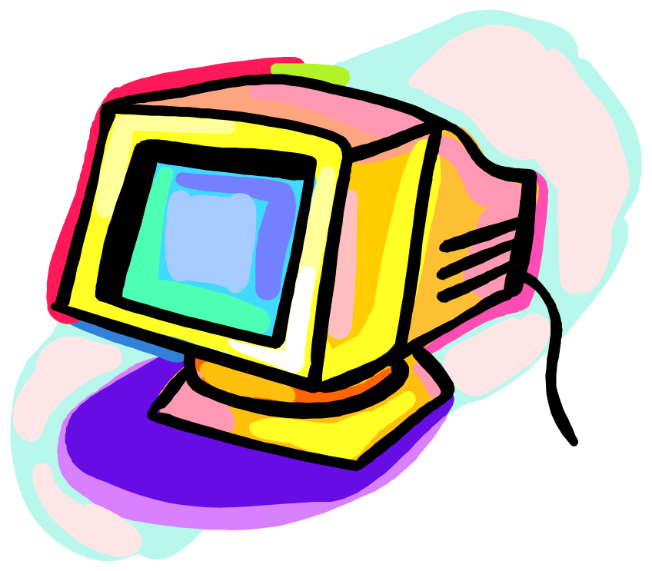
I am a MONITOR.
A monitor is the TV-set-like screen that displays video.

Slide 3
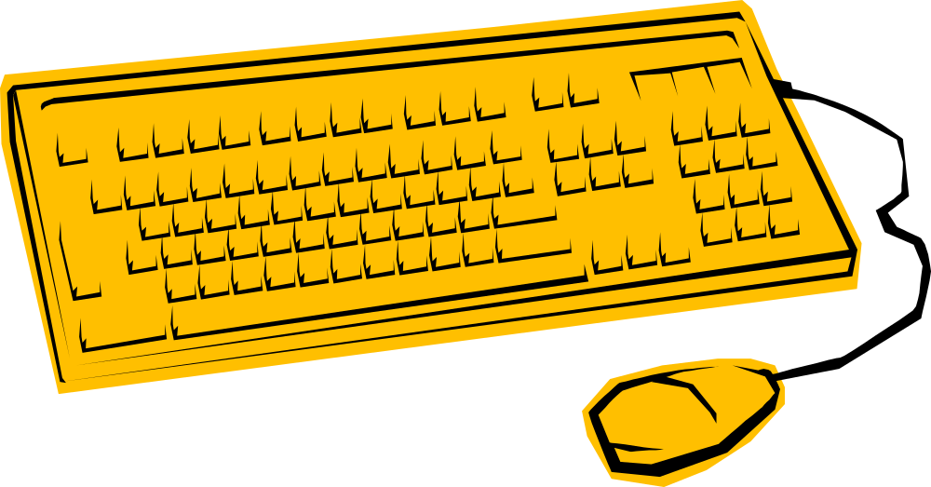
I am a KEYBOARD.
A keyboard is used to type your information.

Slide 4

I am a COMPUTER (CPU).
A computer or central processing
unit stores, recalls, and processes data.

Slide 5

I am a MOUSE.
A mouse moves the cursor on your screen.

Slide 6

I am a PRINTER.
A printer gives an image on paper.

Slide 7

Now Do You Know Mr. Computer?

Slide 8
Who am I?
CPU
Monitor

Slide 9
No, try again …

Slide 10
You are SOOOO clever! Click the button to go to the next question …

Slide 11
Who am I?
Monitor
Keyboard

Slide 12
No, try again …

Slide 13
You are SOOOO clever!
Click the button to go to
the next question…

Slide 14
Who am I?
Keyboard
CPU

Slide 15
No, try again…

Slide 16
You are SOOOO clever!
Click the button to go to
The next question…

Slide 17
Who am I?
CPU
Mouse

Slide 18
No, try again…

Slide 19
You are SOOO clever!
Click the button to go to
The next question…

Slide 20
Who am I?
Mouse
Printer

Slide 21
No, try again…

Slide 22
You are SOOOO clever!

Slide 23
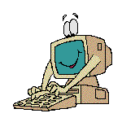
How Did You Do?

